Slide 1
BITS ZG553: Real Time Systems
K G Krishna
WILP Division, BITS-Pilani, Hyderabad

Slide 2
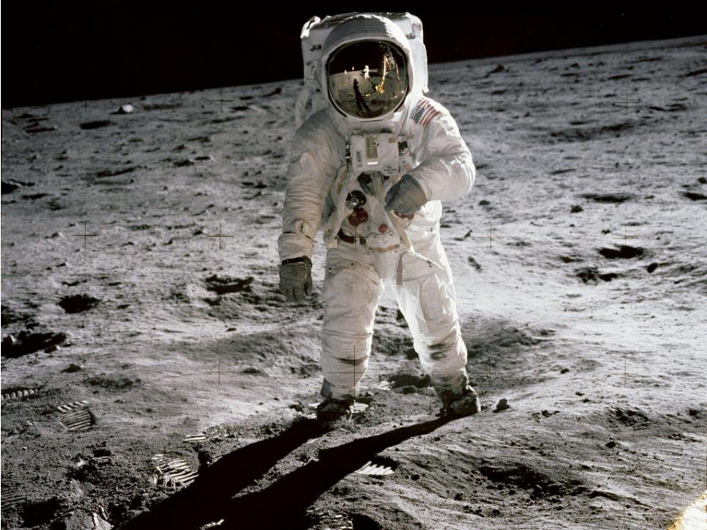
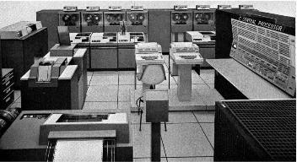

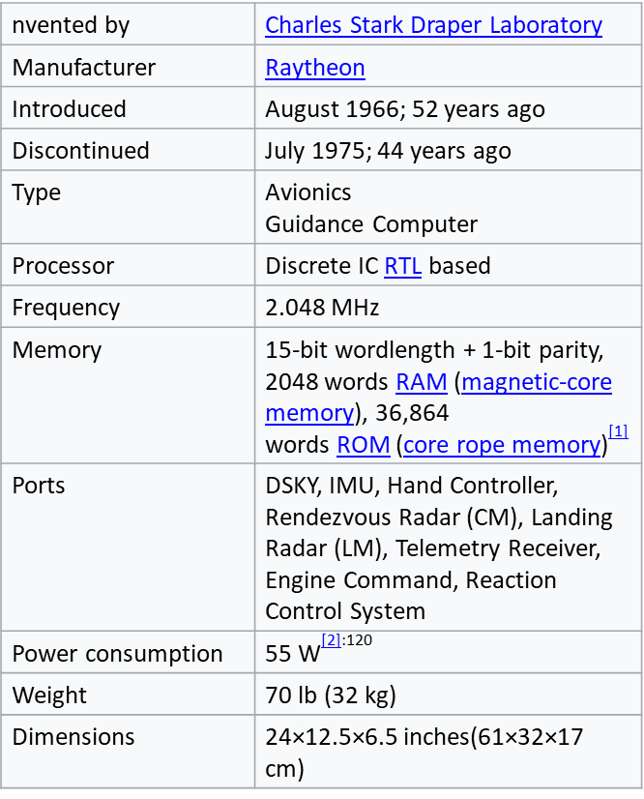
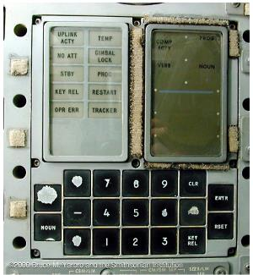
Welcome To BITS ZG553: Real Time Systems - K G Krishna

Slide 3

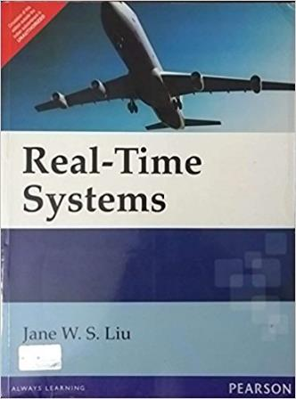
Text Book / References
Reference (R1)
Text Book (T1)
Note: As the above two books focus on theoretical treatment of the subject, Students are strongly advised to refer to web sources / MOOCs videos / library within their own organizations for more practical understanding of the topics.

Slide 4
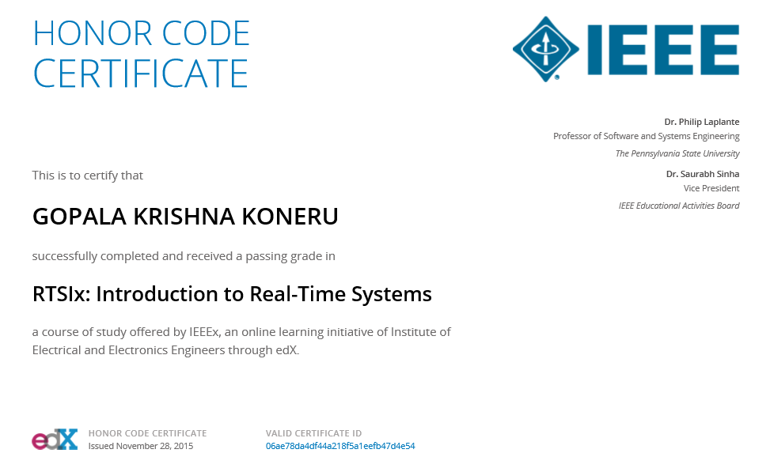
Excellent MOOCs Videos
(Coursera, edX,…)

Slide 5

RTS Primer – For Light Reading

Slide 6
L-1: Real Time Systems – An Introduction
Ref: R1/ [Informal Discussion]
Note: Students are requested to NOT to rely on PPTs/Recorded sessions as their only source of knowledge, explore sources within your own organization or web for any specific topic; attend classes regularly and involve in discussions;
PLEASE DO NOT PRINT PPTs, Save the Environment!
Source PPT Courtesy: Some of the contents of this PPT is sourced from Presentations by Prof K R Anupa, BITS-Pilani, Goa

Slide 7
Real Time Computing
Correctness = Logical Result of Computation + Time at which result is produced
Usually part of a larger cyber-physical system
Response Time – Time between presentation of inputs and the realization of the required behavior.
How Punctual ?? / How Fast ?? – System Specifications

Slide 8
RTS
System satisfies bounded Response Time constraint
Severe Consequence
Is this always failure ???
Safe/ Reliable
RTS are mostly embedded/ reactive
Concurrency
Distributed
Every Practical System is real time

Slide 9
Hard Vs Soft
Soft RTS - Performance is degraded but not destroyed by failure to meet deadlines (response time requirements)
Hard RTS – Even a single deadline missed will be catastrophic or complete failure
Missile Launching System
Video Games
Weed killing robot
Firm RTS – > N deadlines missed – complete failure.

Slide 10
Where deadlines come from?
Animated Display – 30 frames/sec
System Specification
Specification Languages
Predict execution times of programs
Model reliability of s/w and h/w
Assign tasks to processors
Failure Recovery

Slide 11
Structure of a RTS
Controlled Process
Sensors
Job List
Clock
Trigger Generator
Actuators
Execution
Operator

Slide 12
Tasks
Periodic/ Non Periodic
Critical / Non Critical

Slide 13
In terms of Speed
Sensors & Actuators
Peripheral Cluster
Central Cluster

Slide 14
Where do deadlines come from:
Elevator Door Control
 | Contributing parameters | Min | Avg | Max
1 | Sensor Response Time | 5ms | 9ms | 15ms
2 | Hardware Response Time | 1μs | 1.2μs | 2μs
3 | System Software Response Time | 16μs | 37μs | 48μs
4 | Appln Software Response Time | 0.5μs | 0.5μs | 0.5μs
5 | Door Actuator Response Time | 300ms | 400 | 500
 | Contributing parameters | Min | Avg | Max
1 | Sensor Response Time | 5ms | 9ms | 15ms
2 | Hardware Response Time | 1μs | 1.2μs | 2μs
3 | System Software Response Time | 16μs | 37μs | 48μs
4 | Appln Software Response Time | 0.5μs | 0.5μs | 0.5μs
 | Contributing parameters | Min | Avg | Max
 | Sensor Response Time | 5ms | 9ms | 15ms
 | Hardware Response Time | 1μs | 1.2μs | 2μs
 | Contributing parameters | Min | Avg | Max
 | Contributing parameters | Min | Avg | Max
 | Sensor Response Time | 5ms | 9ms | 15ms

Slide 15
Real – Time Punctuality
Every response System has an average t_{R}
Upper Bound t_{R} + ε_{U}
Lower Bound t_{R} - ε_{L}
ε_{U} ε_{L} → 0 ⁺
Practical Systems – non zero
Cumulative latency/ propagation delay in software & hardware

Slide 16
Issues in RTS
Architectural Issues
Processor Architecture
Network Architecture
Clock Sync
Fault Tolerance and Reliability
OS Issues
Task Assignment & Scheduling
Commn Protocols
Failure Management
Clock Sync
Other Issues
Programming Languages
Databases
Performance Measures

Slide 17
Hard Vs Soft
Soft RTS - Performance is degraded but not destroyed by failure to meet deadlines (response time requirements)
Hard RTS – Even a single deadline missed will be catastrophic or complete failure
Missile Launching System
Video Games
Weed killing robot
Firm RTS – > N deadlines missed – complete failure.

Slide 18
Where deadlines come from?
Animated Display – 30 frames/sec
System Specification
Specification Languages
Predict execution times of programs
Model reliability of s/w and h/w
Assign tasks to processors
Failure Recovery

Slide 19
A System
(Source: P. A. Laplante & S. J. Ovaska, Real-Time Systems Design and Analysis: Tools for the Practitioner, Wiley, 4th edition)
A system is an assembly of components connected together in an organized way
A system is fundamentally altered if a component joins or leaves it
It has a purpose
It has a degree of permanence
It has been defined as being of particular interest

Slide 20
Example: A Real-Time Control System
Inputs are excitations and outputs are corresponding responses
Inputs and outputs may be digital or analog
Inputs are associated with sensors, cameras, etc.
Outputs with actuators, displays, etc.
Source: P. A. Laplante & S. J. Ovaska, Real-Time Systems Design and Analysis: Tools for the Practitioner, Wiley, 4th edition

Slide 21
Sample Data System
Feedback Control Loop pseudocode:
set timer to interrupt periodically with period ‘T’
at each timer interrupt do
{
do analogue-to-digital conversion to get ‘y’
compute control output ‘u’
do digital-to-analogue conversion
}

Slide 22
Sample Data System
Determining the Sampling Rate
Sampling time interval = T
In general, the faster a system can and must respond to changes, the faster the input to the actuator varies, hence the shorter the sampling period should be.
We can measure the responsiveness of the system by its rise time R.
R is the time it takes to get close to its final state after the input changes.
Typically the ratio R/T of rise time to sampling period should be between 10 and 20 in order to give a smooth response.
One can also consider this in terms of bandwidth ω which is approximately 1/2R Hz.
The Nyquist sampling theorem says that any time-continuous signal of bandwidth ω can be reproduced faithfully from its sampled values only if the sampling rate is at least 2 ω.
Recommended sampling rate is 20 to 40 times the bandwidth ω.

Slide 23
Sample Data System
Multirate System
A system typically has state defined by multiple state variables. e.g. rotation speed, temperature, fuel consumption, etc. of an engine.
The state is monitored by multiple sensors and controlled by multiple actuators.
Hence there are multiple sampling rates, one for each state variable.
A system with multiple sampling rates is called a multirate system.
Determining Sampling Rate for a Multirate System
Fastest sample rate is the choice ?
Usually longer sampling period is an integer multiple of every shorter sampling period
Design is done in iterative way
Select the fastest sampling rate controller assuming it is independent of other controller. Integrate it with the plant
Select the next fastest one and integrate. Continue till the slowest sampling rate controller is integrated
Correct the error, aroused due to the assumption that the first one is independent of others

Slide 24
A More Complex Control Law Computation
Set timer to interrupt periodically with period ‘T’
At each timer interrupt do
{
Sample and digitize sensor readings;
Compute control output from measured and state-variable values;
Convert control output to analogue form;
Estimate and update system parameters;
Compute and update state variables;
}

Slide 25
Controller Hierarchy
Controllers in a complex systems are typically organised hierarchically.
Example – Air Traffic Control System
The air-traffic control system is at the highest level.
Regulates the flow of flights to the destination
Does by assigning each aircraft an arrival time at each metering fix (a geographical point) en route to the destination
Assigned arrival time to the next metering fix is the reference for the on board flight management system
The on-board flight management system chooses the flight paths etc. and sets parameters for the lower level controllers.
It has to optimize the flight path based on certain constraints
Constrains include the ones imposed by the flight characteristics such as maximum and minimum allowed cruise speeds and decent/accent rates.
Another constraint is the cost i.e. Fuel consumption. A most desirable path is the most fuel efficient path.
When the flight is late, it should try to bring the aircraft to the next metering fix in the shortest time.
The flight controller at the lowest level handles cruise speed, turn radius, ascend/descend rates etc.

Slide 26
Controller Hierarchy
Air Traffic Control System
Real Time Command and Control Operation
ATC gathers information on the state of each aircraft via one or more active radars.
Such radars interrogates the aircrafts periodically and the aircraft responds with its state variables such as identifiers, position, altitude, heading etc.
ATC stores the information received from the aircrafts in a database.
This information is processed by the processors.
At the same time the surveillance system continuously analyzes the scenario and alerts the operators whenever there is a possibility of collision.

Slide 27
Real Time Application – Real Time Database
Refers to diverse spectrum from stock price information system to track record databases
Real-time data is perishable (in contrast with non-real time data such as pay-roll database)
The age of an object measures how up-to-date the information is. It is the length of the time since the instant of its last update.
The age of an object whose value is computed from other objects is equal to that of the oldest of those objects.
Absolute Temporal Consistency
A set of data objects is said to be absolutely temporally consistent if the maximum age in the set is no greater than a certain threshold.
Examples:
A fighter jet and the targets it tracks move at supersonic speeds, so the information on where they are must be is less than 50 ms.
An air traffic control system monitors commercial aircrafts at subsonic speed, hence the absolute temporal consistency threshold for it is much larger
Relative Temporal Consistency
A set of data objects is said to be relatively temporally consistent if the maximum difference in ages of the objects in the set is no greater than the relative consistency threshold used by the application.

Slide 28
Real Time Application – Multimedia Systems
MPEG Compression / Decompression
Motion Estimation
Discrete Cosine Transform / Inverse Discrete Cosine Transform
Huffman Encoding / Decoding
Real Time Characteristics
SD Video requires 30 frames per sec, HD video requires 60 frames per sec
Lower frame-rates are fine for applications like video conferencing
DCT/IDCT, Motion Estimation and Compensation and Huffman Encoding / Decoding are computation intensive.
Computation need to be done per frame basis.
Lip-sync between Audio and Video also need to be performed.
Muxing / Demuxing also add to the computation.

Slide 29
Types of Real Time Systems
Purely cyclic
Every task executes periodically. Even I/O operations are polled.
Demands on resources do not vary significantly from period to period.
Example: Real-time monitors
Mostly cyclic
Most tasks execute periodically.
The system can also respond to some external events asynchronously.
Example: Process control systems
Asynchronous and somewhat predictable
Most tasks are not periodic.
Duration between executions of a task may vary considerably or the resource requirements may vary. Variations have bounded ranges or known statistics.
Example: Multimedia systems, Radar signal processing
Asynchronous and unpredictable
Systems which react to asynchronous events and have tasks with high run-time complexity.
Example: Intelligent real-time control system

Slide 30
Soft & Hard Real Time Systems
Soft Real Time System
A soft real-time system is one in which performance is degraded but not destroyed by failure to meet response-time constraints.
User requires only a demonstration that the system always meet some statistical constraints.
Best effort service
Example: Multimedia system
Hard Real Time System
A hard real-time system is one in which failure to meet a single deadline may lead to complete and catastrophic system failure
User requires validation that the system always meet the timing constraint. (validation means demonstration by a provably correct and efficient procedure)
Guaranteed service
Example: Avionics weapons delivery system
Firm Real Time System
A firm real-time system is one in which failure to meet a single deadline will not lead to total system failure, but missing more than few may lead to complete and catastrophic system failure
Example: Navigation controller for an autonomous weed-killer robot
(In most of the texts, Firm Realtime Systems are not mentioned)

Slide 31
Jobs and Tasks
Job: Each unit of work that is scheduled and executed by the system is a job.
Task: A set of related jobs which jointly provide some system function is a task.
Example:
Computation of FFT (Fast Fourier Transform) of sensor data at a particular time instance, sending a data packet are examples of job.
Whereas the function of sending data packets is an example of a task.

Slide 32
{Processors, Servers, Resources}
The jobs are executed by operating systems.
Each job requires some resource to execute such as a CPU, a Network, a Disk etc.
In Queuing Theory, these are called Servers.
In Operating Systems literature, these are called Active Resources.
Here we will call them Processors.

Slide 33
Release Time and Deadline
Release time of a job is the instance of time at which the job becomes available for execution.
Deadline of a job is the instant of time by which its execution is required to be completed.
It is also called Absolute Deadline.
Relative Deadline = Absolute Deadline – Release time.

Slide 34
Example
A system which monitors and controls several furnaces
At the beginning, the system is initialized and starts execution (time 0 ms).
The system samples and reads each temperature sensor every 100 ms.
The system computes the control law of each furnace every 100 ms.
Each of the control law computation is a job, say J_{k}, k = 0, 1, 2, ….
The function of control law computation all the time is a task.
The first control law computation started at 20 ms.
So, release time of first job, r₀ = 20 ms
Subsequent release times: 120 ms, 220 ms, …
So release time of kth job r_{k} = (20 + 100 * k) ms
If each job needs to be completed within 70 ms, then the absolute deadlines of the jobs: 90 ms, 190 ms, 290 ms, …
Relative deadline D_{k} = 70 ms

Slide 35
Response Time
The time between the presentation of a set of inputs to a system and the realization of the required behavior, including the availability of all associated outputs, is called the response time of the system
In other words, Response time is the length of the time from the release time of the job and the time instance when it completes.
So Relative Deadline is the maximum allowable Response Time.

Slide 36
Real-Time Punctuality
Real Time Punctuality means every response time has an average value t_{R} with upper and lower bounds of (t_{R} + Ɛ_{U}) and (t_{R} – Ɛ_{L}) with Ɛ_{U}, Ɛ_{L} -> 0⁺.
In all practical situations, Ɛ_{U}, Ɛ_{L} ≠ 0.
It is due to the propagation delays and cumulative latencies in both hardware and software components.
So the response time will have jitter within the interval [–Ɛ_{L} , +Ɛ_{U}].

Slide 37
Response Time - Example
For the door reopening operation of an elevator system, individual response times of the component involved are following.
Components | Min Response Time | Max Response Time
Sensor | 5 ms | 15 ms
Hardware | 1 μs | 2 μs
System Software | 16 μs | 48 μs
Application Software | 0.5 μs | 0.5 μs
Door drive | 300 ms | 500 ms
Total | 305 ms | 515 ms
Please note that overall response time is dominated by the response time of the door drive.

Slide 38
Some Other Definitions
Hard and Soft Deadlines
A timing constraint or deadline is hard, if the failure to meet it is considered to be a fatal fault.
A late completion of a job that has a soft deadline is undesirable. However, few misses of soft deadline don’t cause serious harm.
Tardiness
The tardiness of a job measures how late it completes respective to its deadline.
Tardiness is 0, if it completes at or before the deadline
Tardiness is positive and is equal to the difference between its completion time and the deadline, if the job completes after the deadline.
Usefulness
Usefulness of a hard real-time job falls off abruptly and becomes negative when its tardiness becomes positive.
Usefulness of a soft real-time job decreases as the tardiness increases.
The deadline of a job is softer if its usefulness decreases at slower rate as its tardiness increases.

Slide 39
Real Time Systems:
Usual Misconceptions
Real-time systems are synonymous with “fast” systems
Many (but not all) hard real-time systems deal with deadlines in the tens of milliseconds
There are universal, widely accepted methodologies for real-time systems specification and design
There is still no methodology available that answers all of the challenges of real-time specification and design all the time and for all applications
There is no more a need to build a real-time operating system, because many commercial products exist
Commercial solutions have certainly their place, but choosing when to use an off-the-shelf solution and choosing the right one are continuing challenges
Rate-monotonic analysis has solved “the real-time problem”
While rate-monotonic systems provide guidance in the design of real-time systems, and while there is theory surrounding them, they are not a panacea
The study of real-time systems is mostly about scheduling theory
While it is scholarly to study scheduling theory, most published results require impractical simplifications and clairvoyance in order to make the theory work

Slide 40
Supporting Discplines for “Real-Time Systems”
Source: P. A. Laplante & S. J. Ovaska, Real-Time Systems Design and Analysis: Tools for the Practitioner, Wiley, 4th edition

Slide 41
Thank You.
Any Questions?

